Slide 1
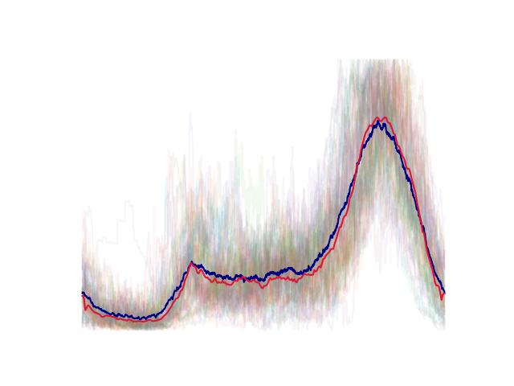
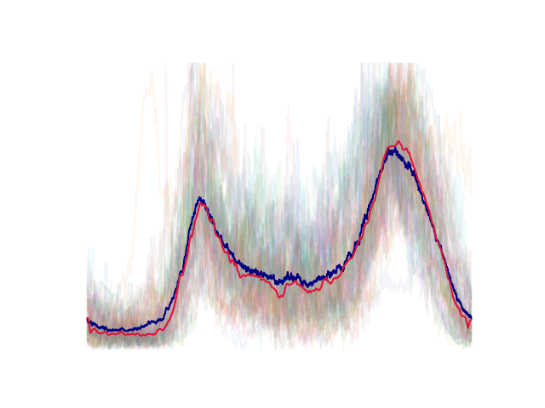
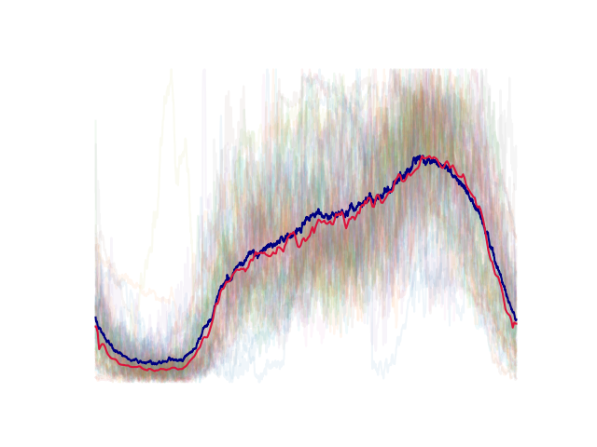
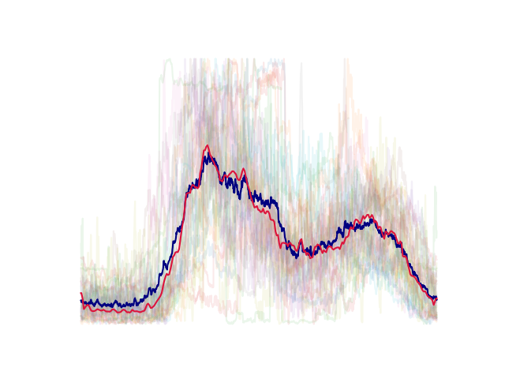
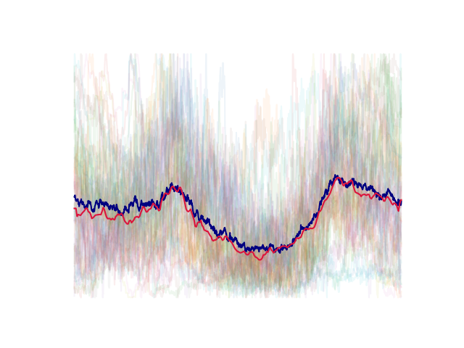
Exploring daily load profile clustering
with Convolutional Autoencoders
Members : Chen Ang
Fu Quanzhi

Slide 2
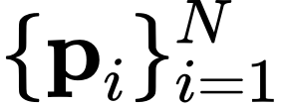
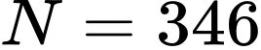
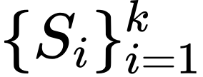
Problem formulation
Given: Average daily load profiles of residents with granularity 1 minute, all normalized to [0, 1].
Goal: Find a k-partition of the profiles such that similar profiles are clustered into the same set.

Slide 3
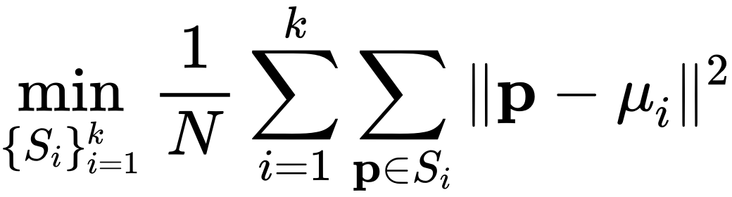
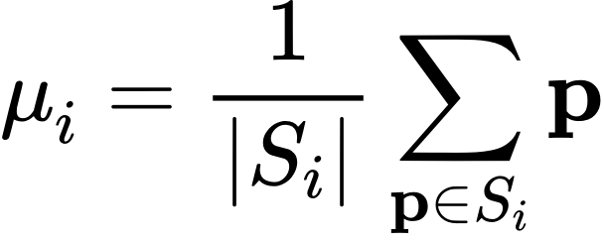
Problem formulation
Given: Average daily load profiles of residents with granularity 1 minute, all normalized to [0, 1].
Goal: Find a k-partition of the profiles such that similar profiles are clustered into the same set.
How to measure similarity?
K-means algorithm?

Slide 4
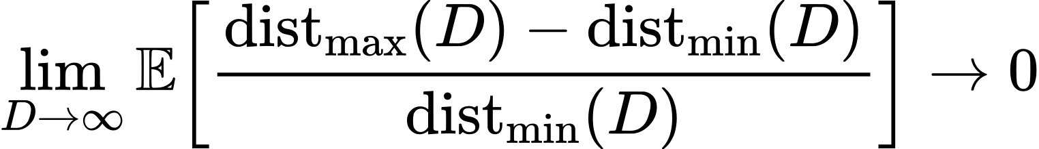
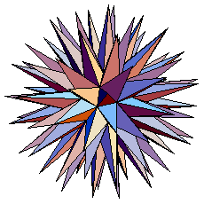
Curse of dimensionality
(Beyer, Goldstein, Ramakrishnan, Shaft)
high-dimensional geometry
(in our case, D = 1440)

Slide 5
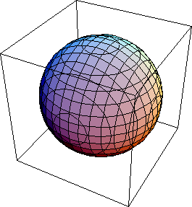
Curse of dimensionality
(Beyer, Goldstein, Ramakrishnan, Shaft)
Dimension reduction
high-dimensional geometry
(in our case, D = 1440)
low-dimensional geometry
(d = 3)

Slide 6
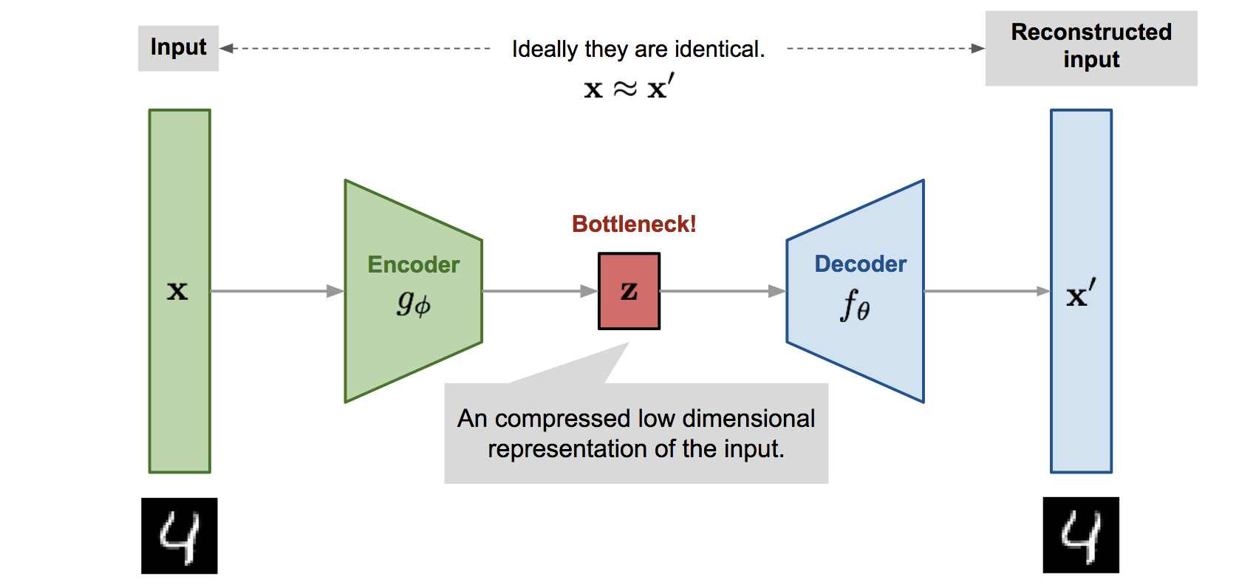
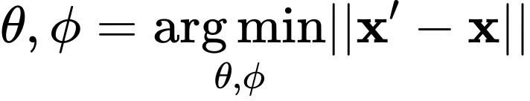
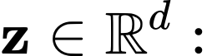
Autoencoder
low dimensional latent variable.
A generic autoencoder

Slide 7
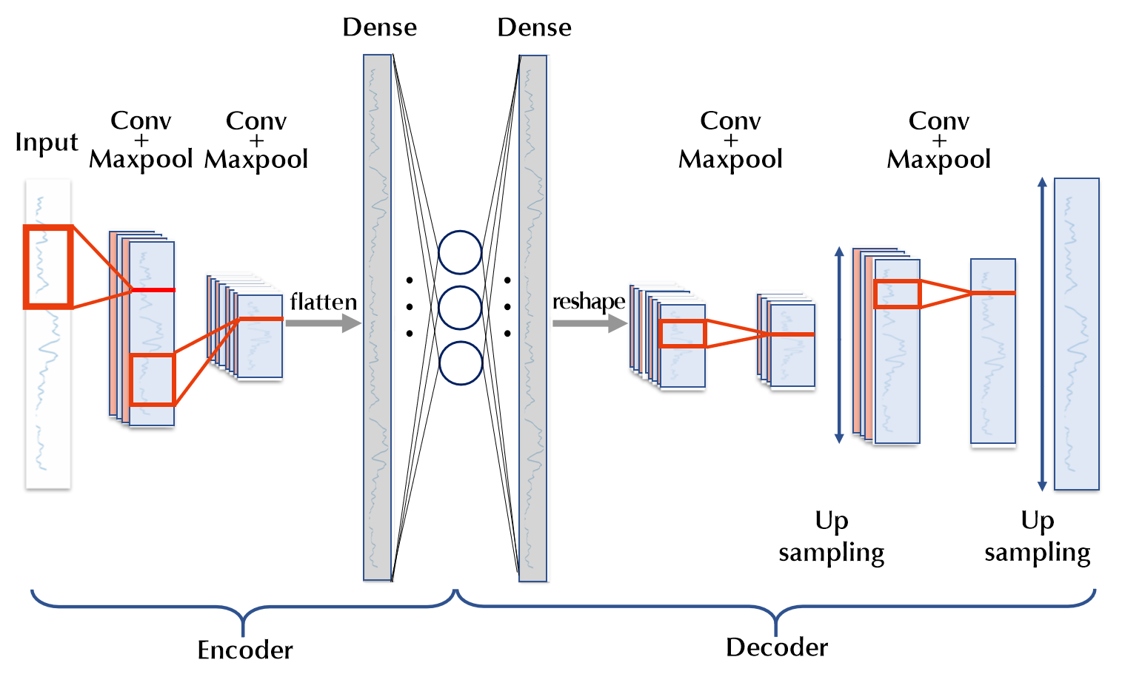
Architecture of our autoencoder

Slide 8
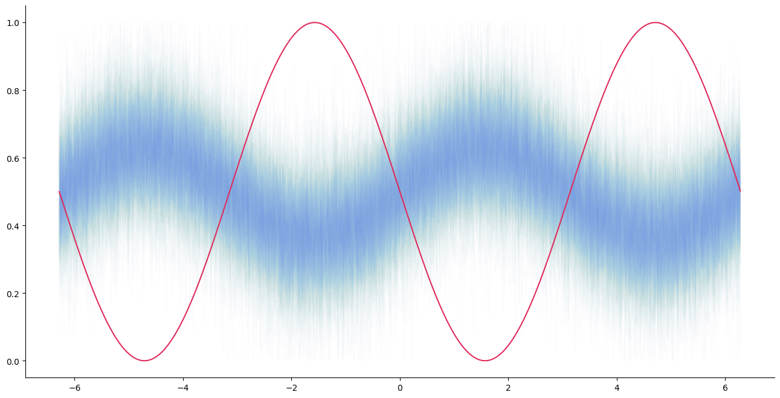
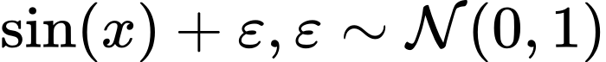
Experiments with sinusoidals
Cluster #1 (N = 100):
Cluster #2 (N = 1):

Slide 9
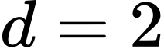
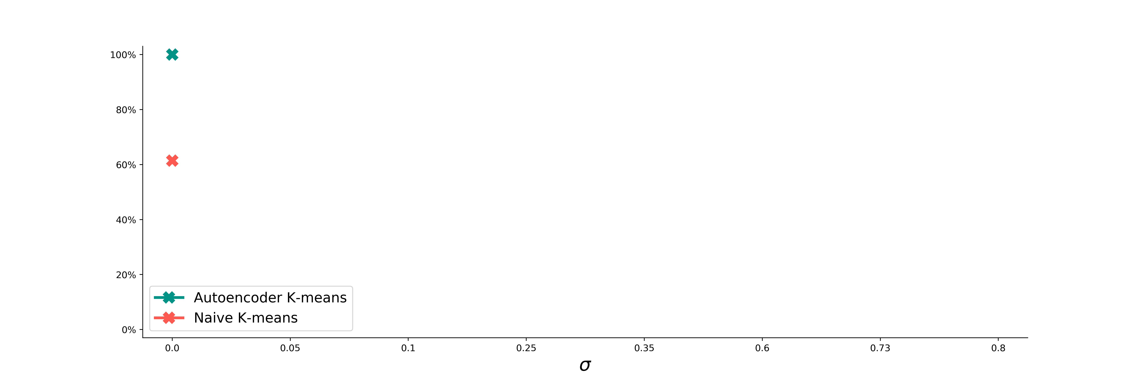
Success rates of clustering:
Naive K-means vs. Autoencoder ( )

Slide 10
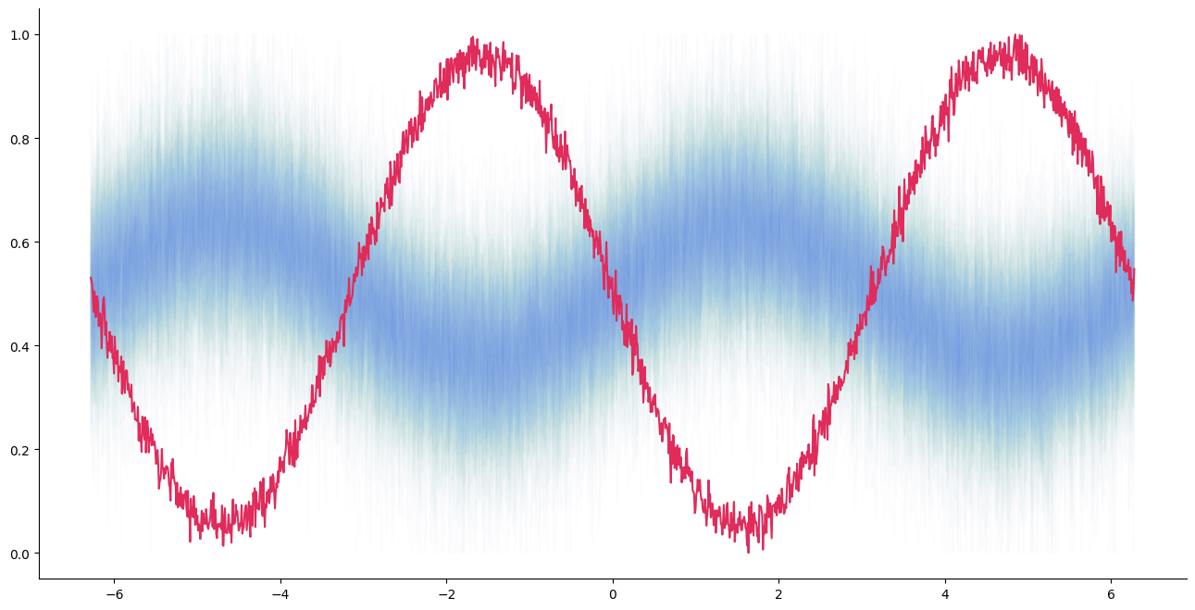
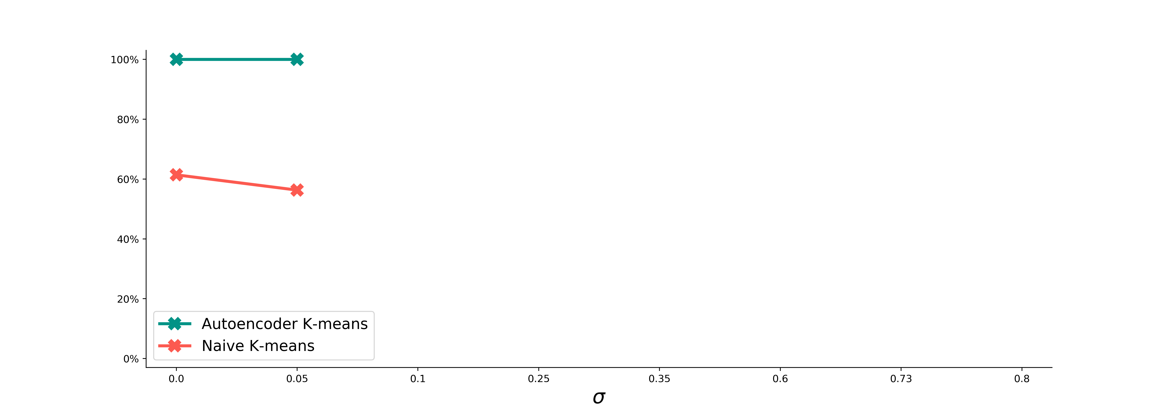
Success rates of clustering:
Naive K-means vs. Autoencoder ( )

Slide 11
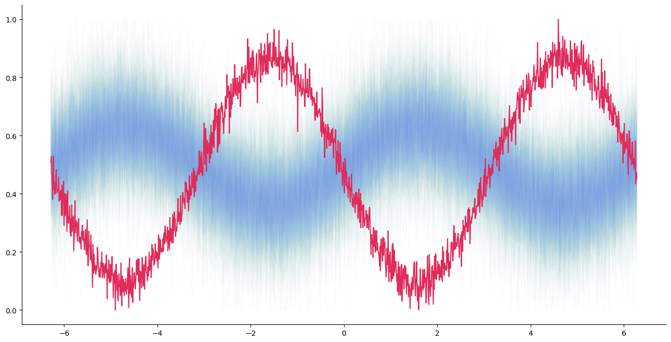
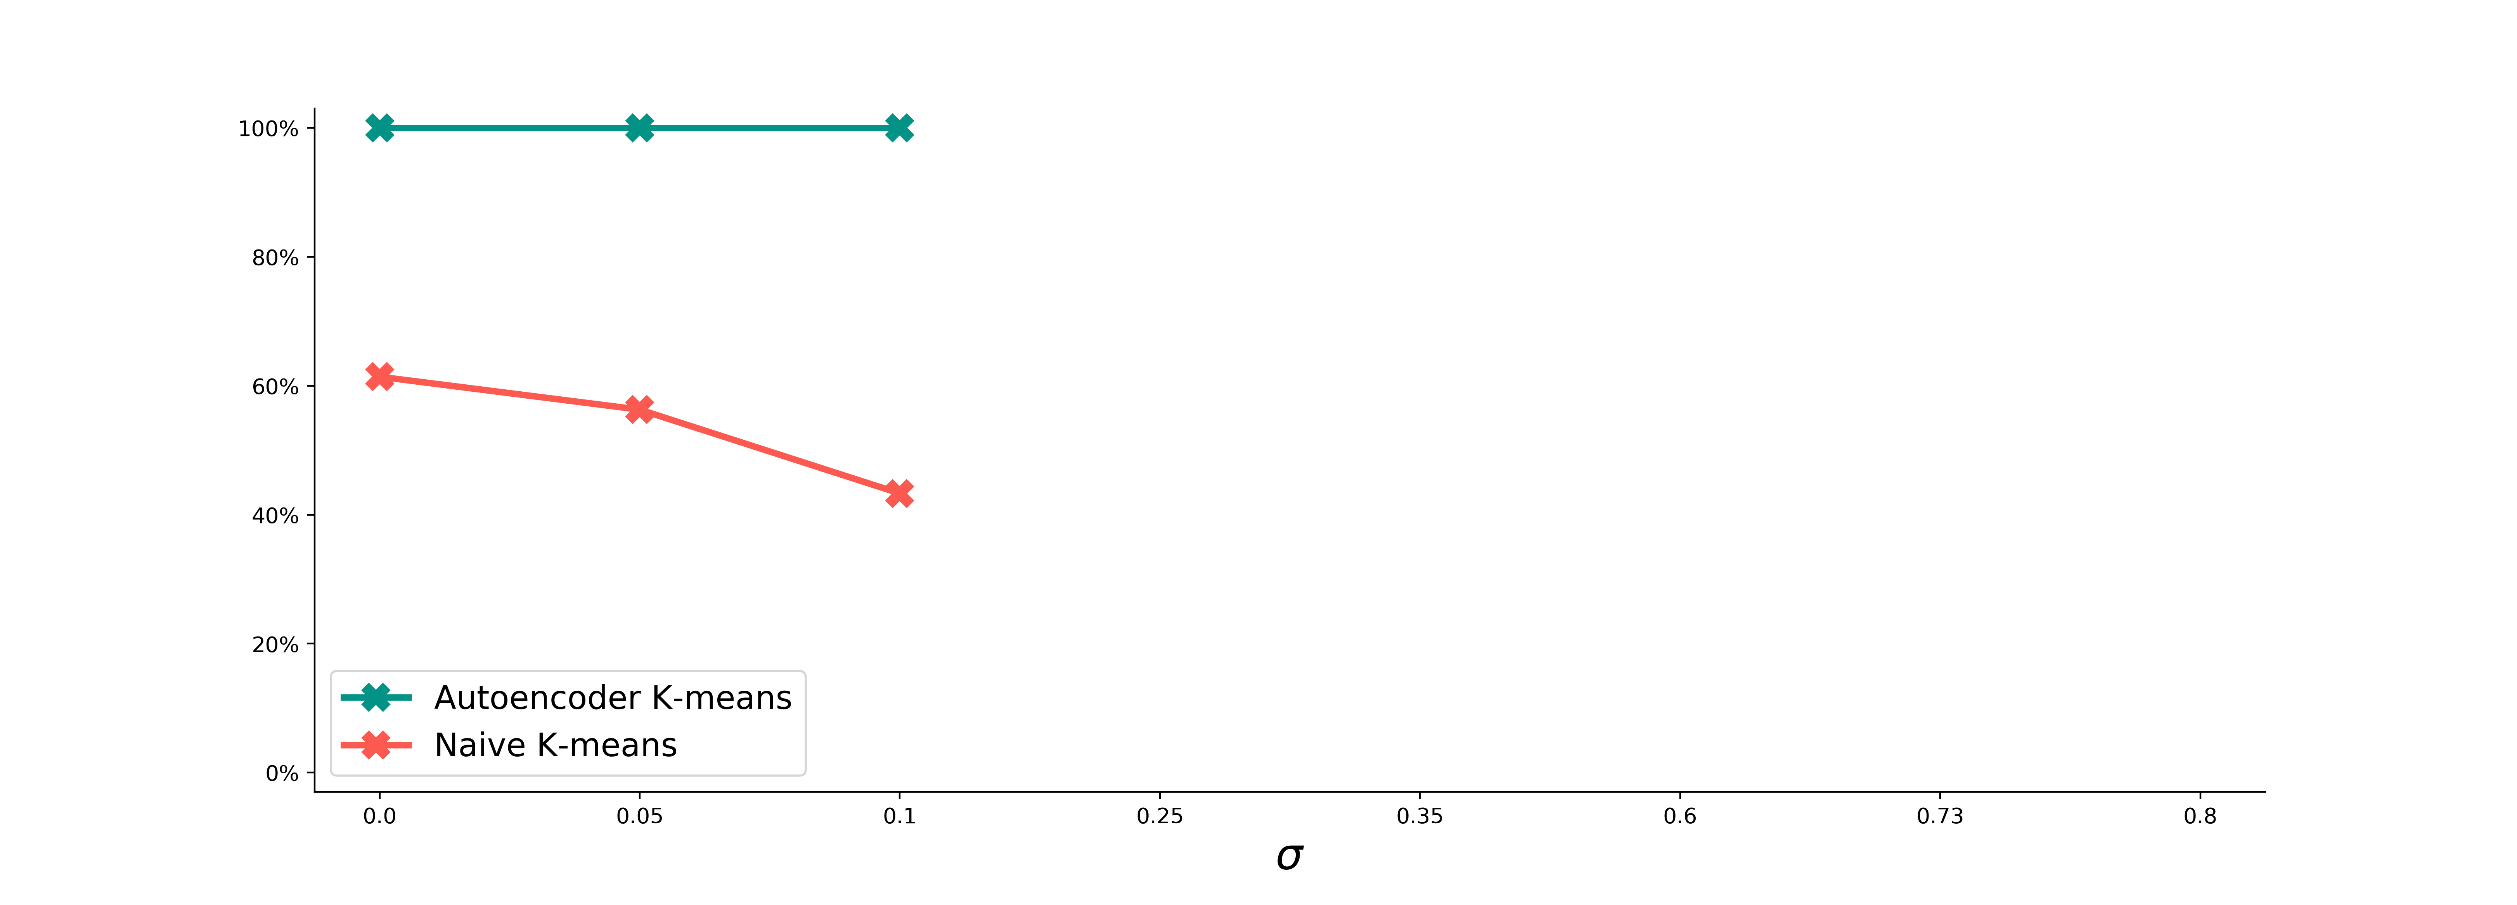
Success rates of clustering:
Naive K-means vs. Autoencoder ( )

Slide 12
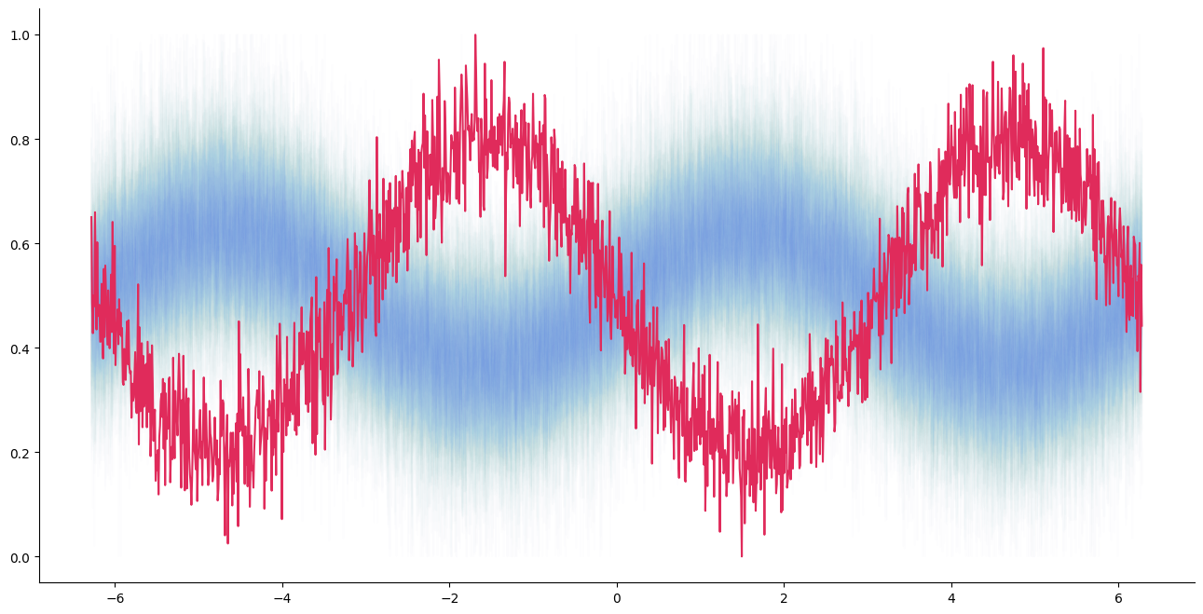
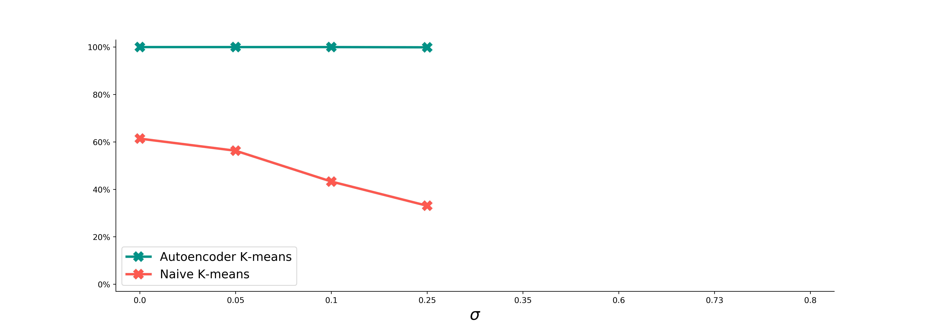
Success rates of clustering:
Naive K-means vs. Autoencoder ( )

Slide 13
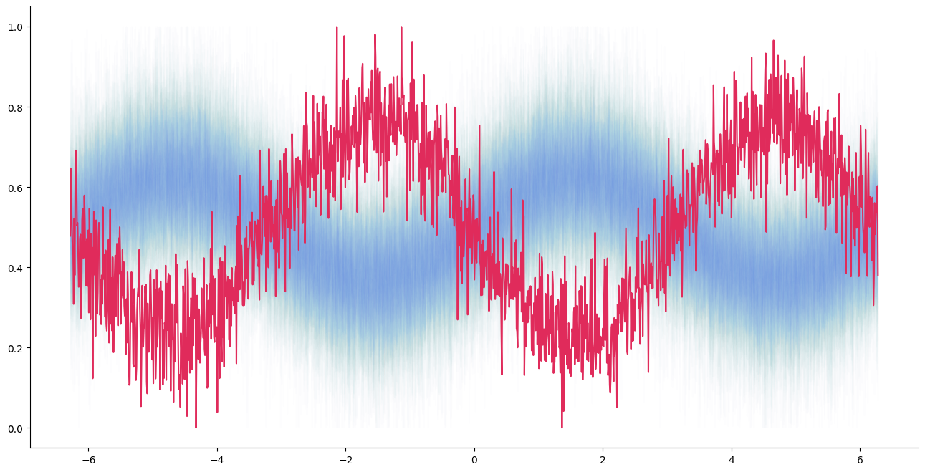
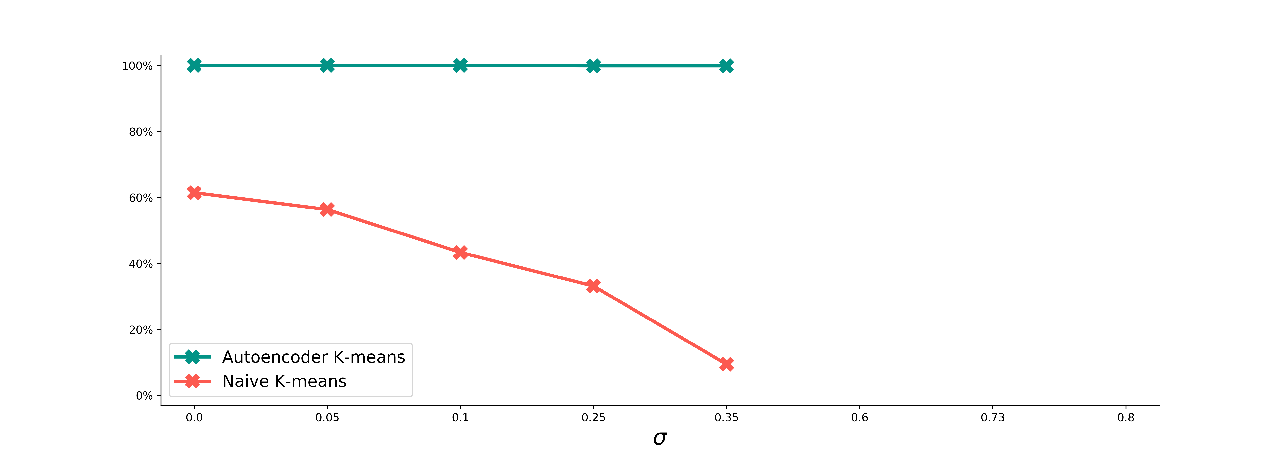
Success rates of clustering:
Naive K-means vs. Autoencoder ( )

Slide 14
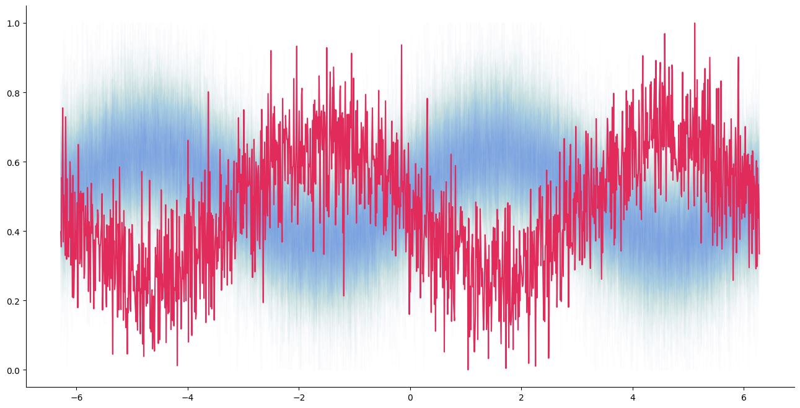
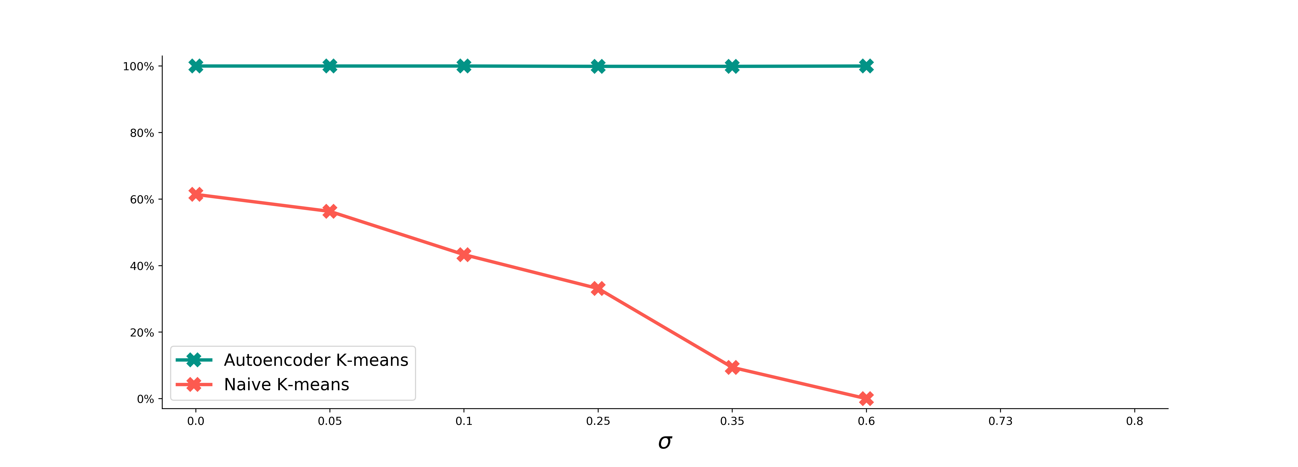
Success rates of clustering:
Naive K-means vs. Autoencoder ( )

Slide 15
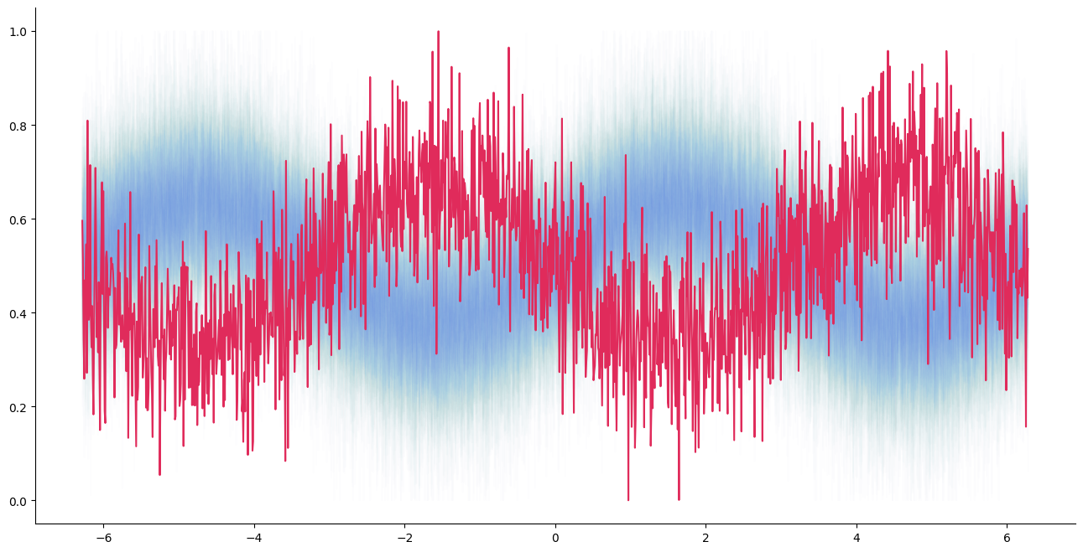
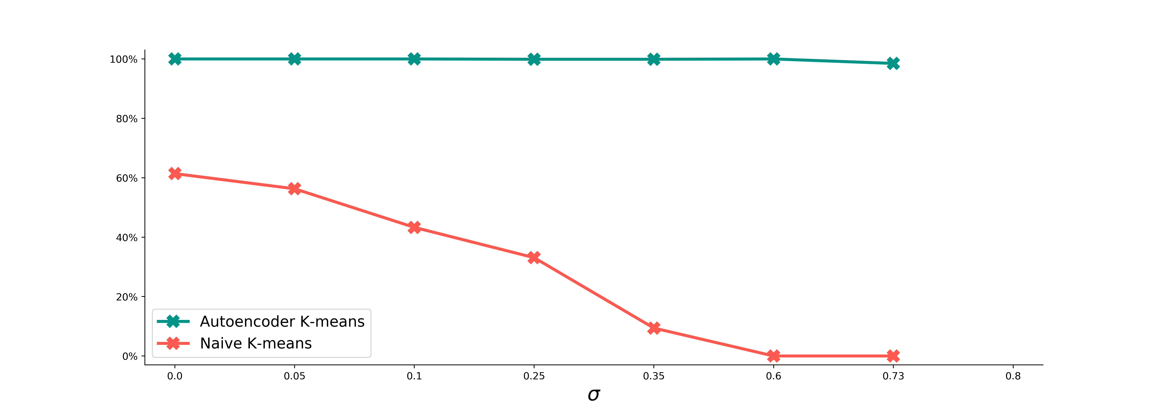
Success rates of clustering:
Naive K-means vs. Autoencoder ( )

Slide 16
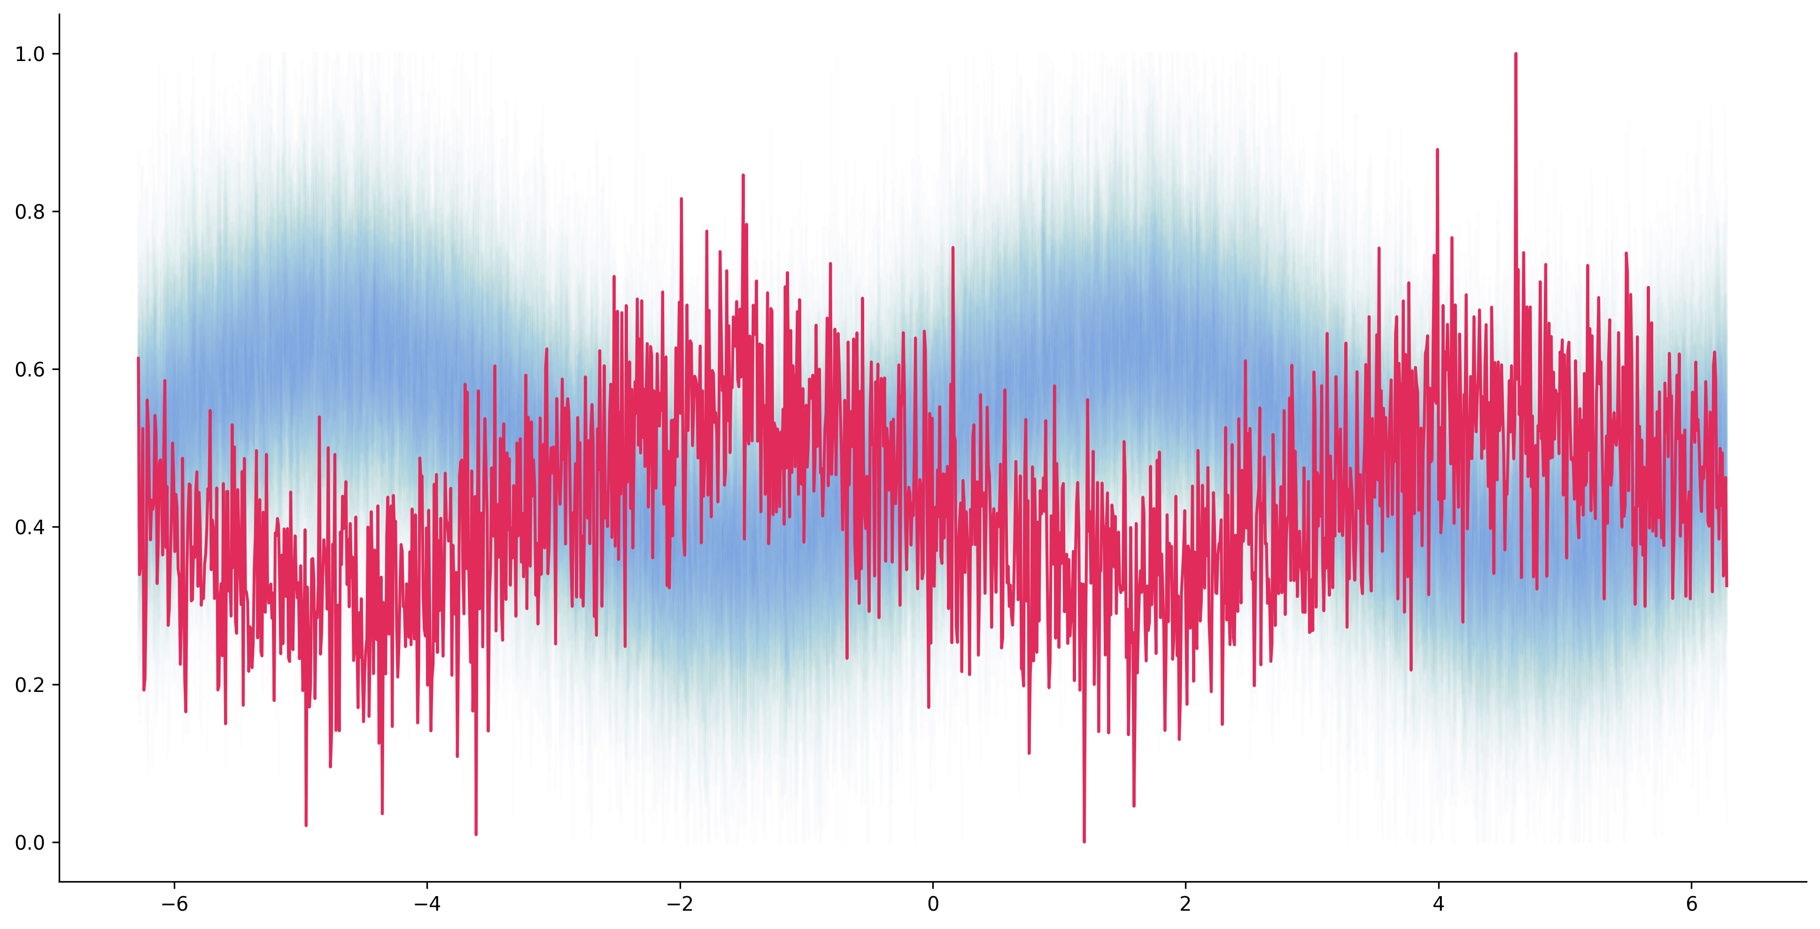
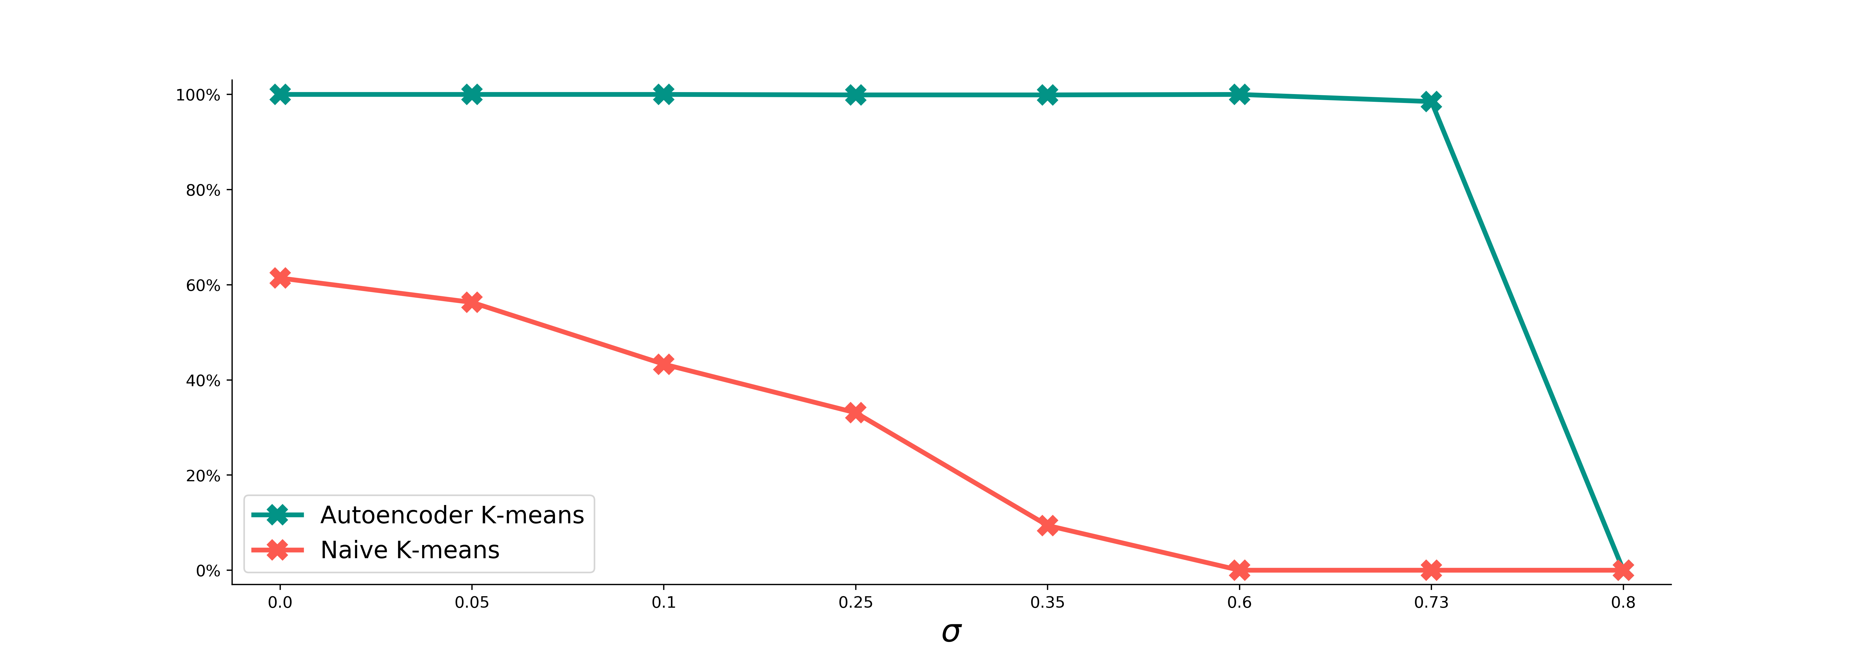
Success rates of clustering:
Naive K-means vs. Autoencoder ( )

Slide 17
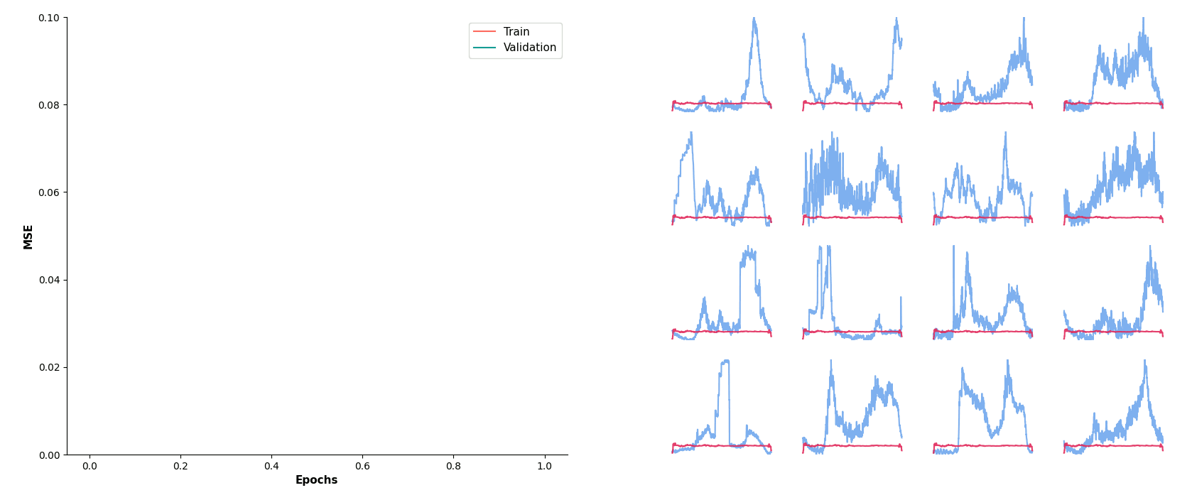
Training dynamics
Reconstruction loss
Reconstructed profiles

Slide 18
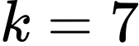
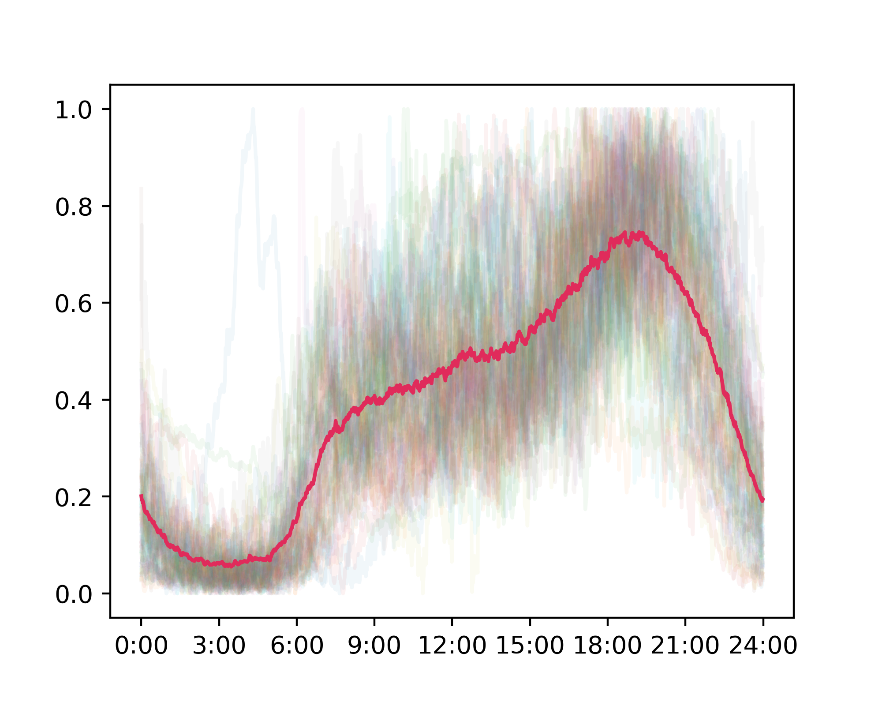
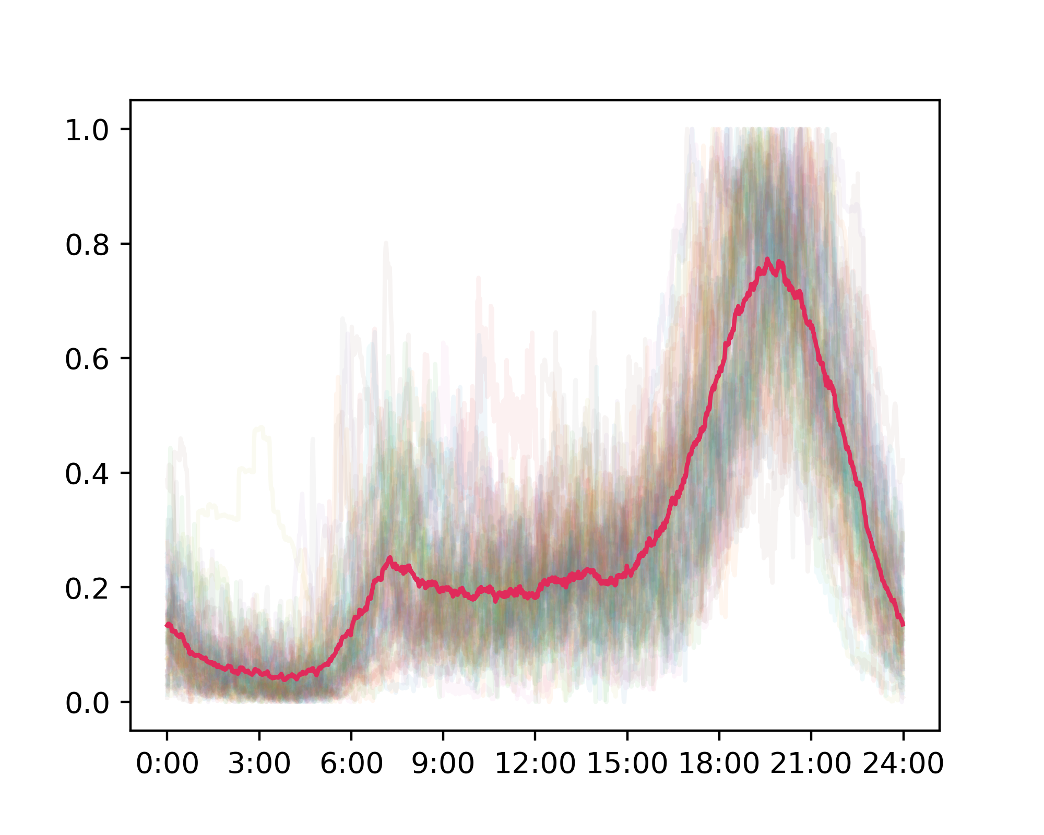
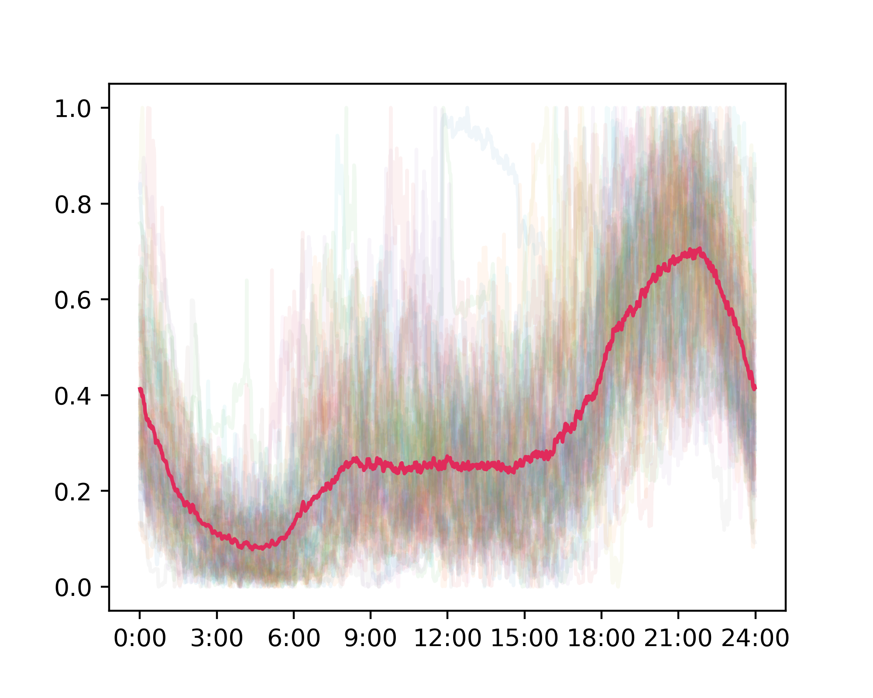
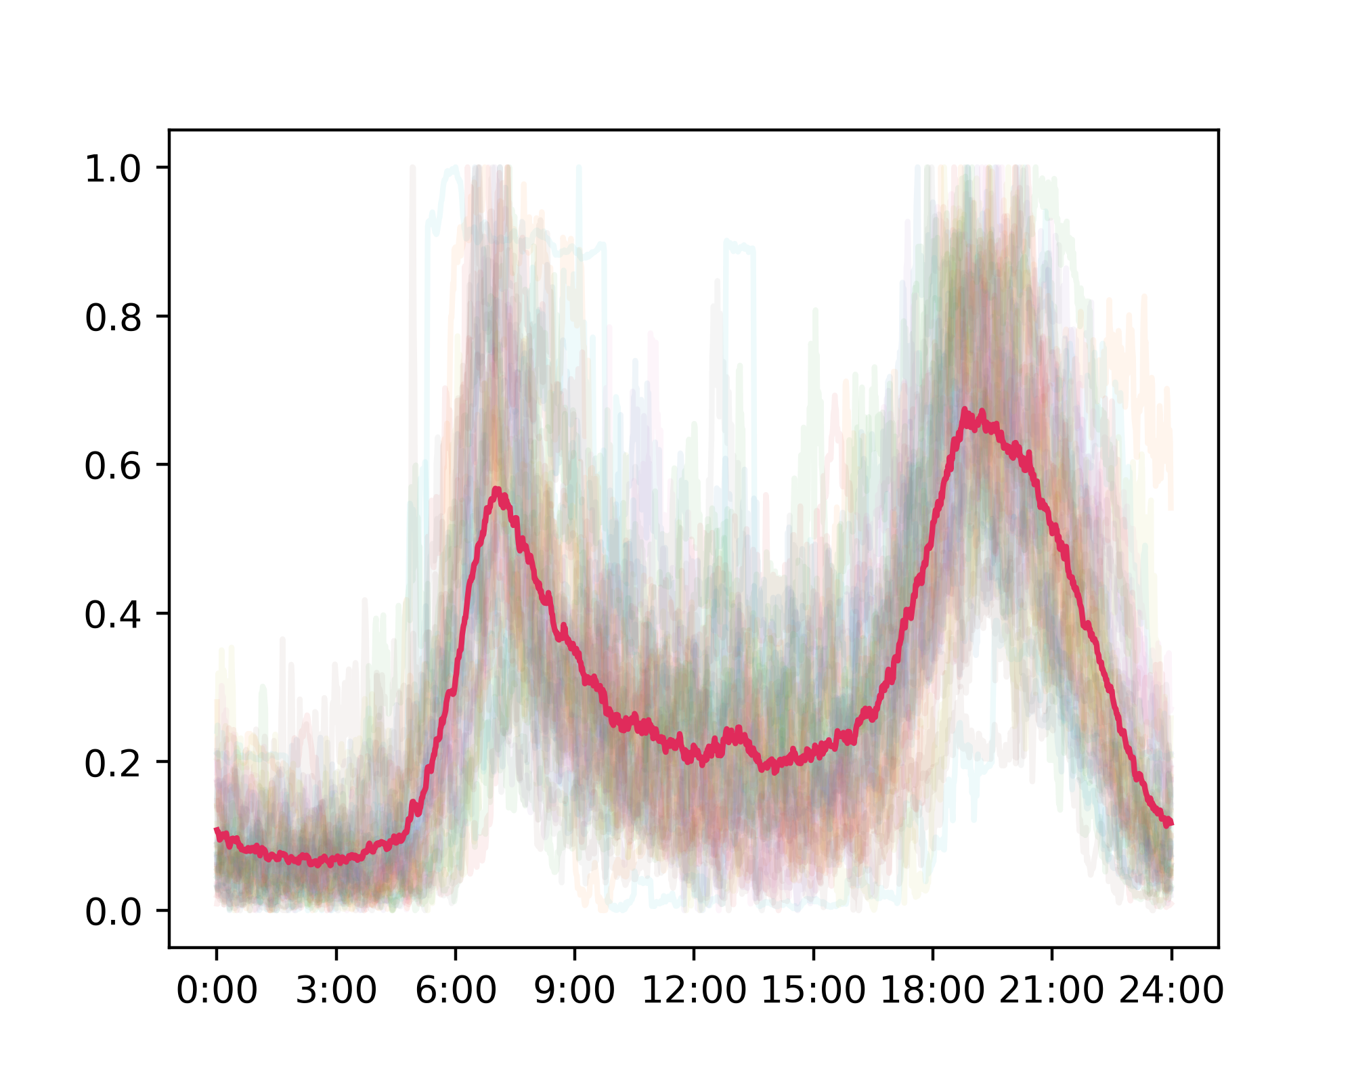
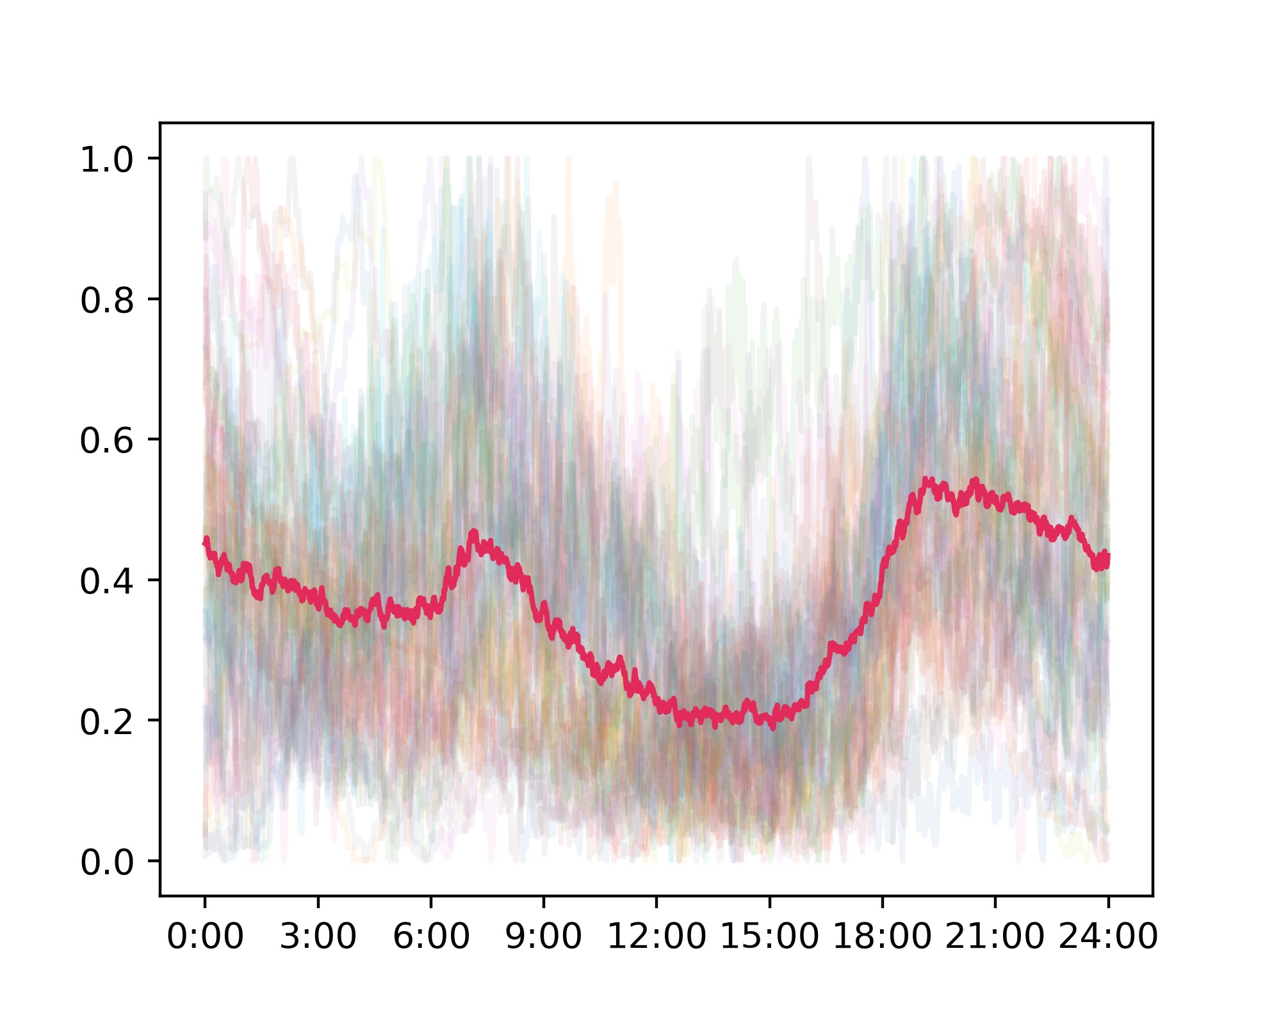
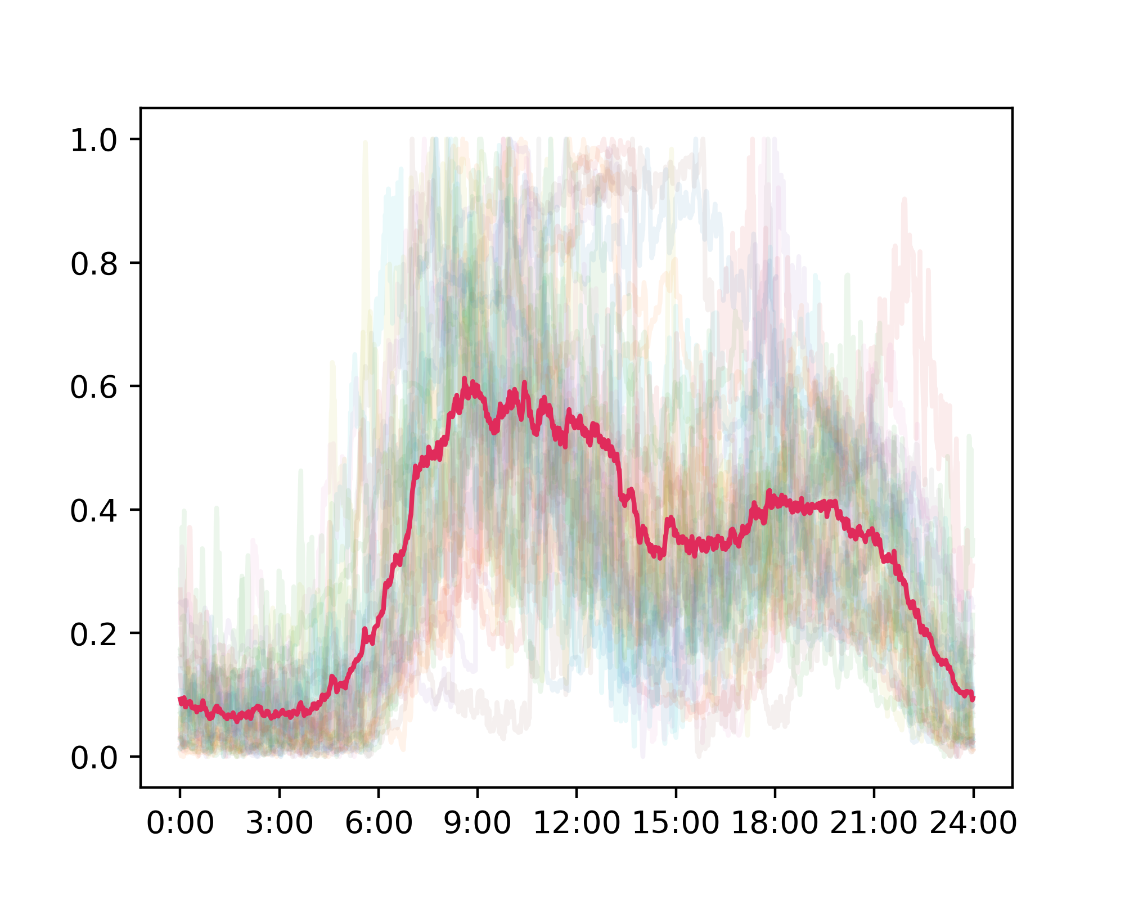
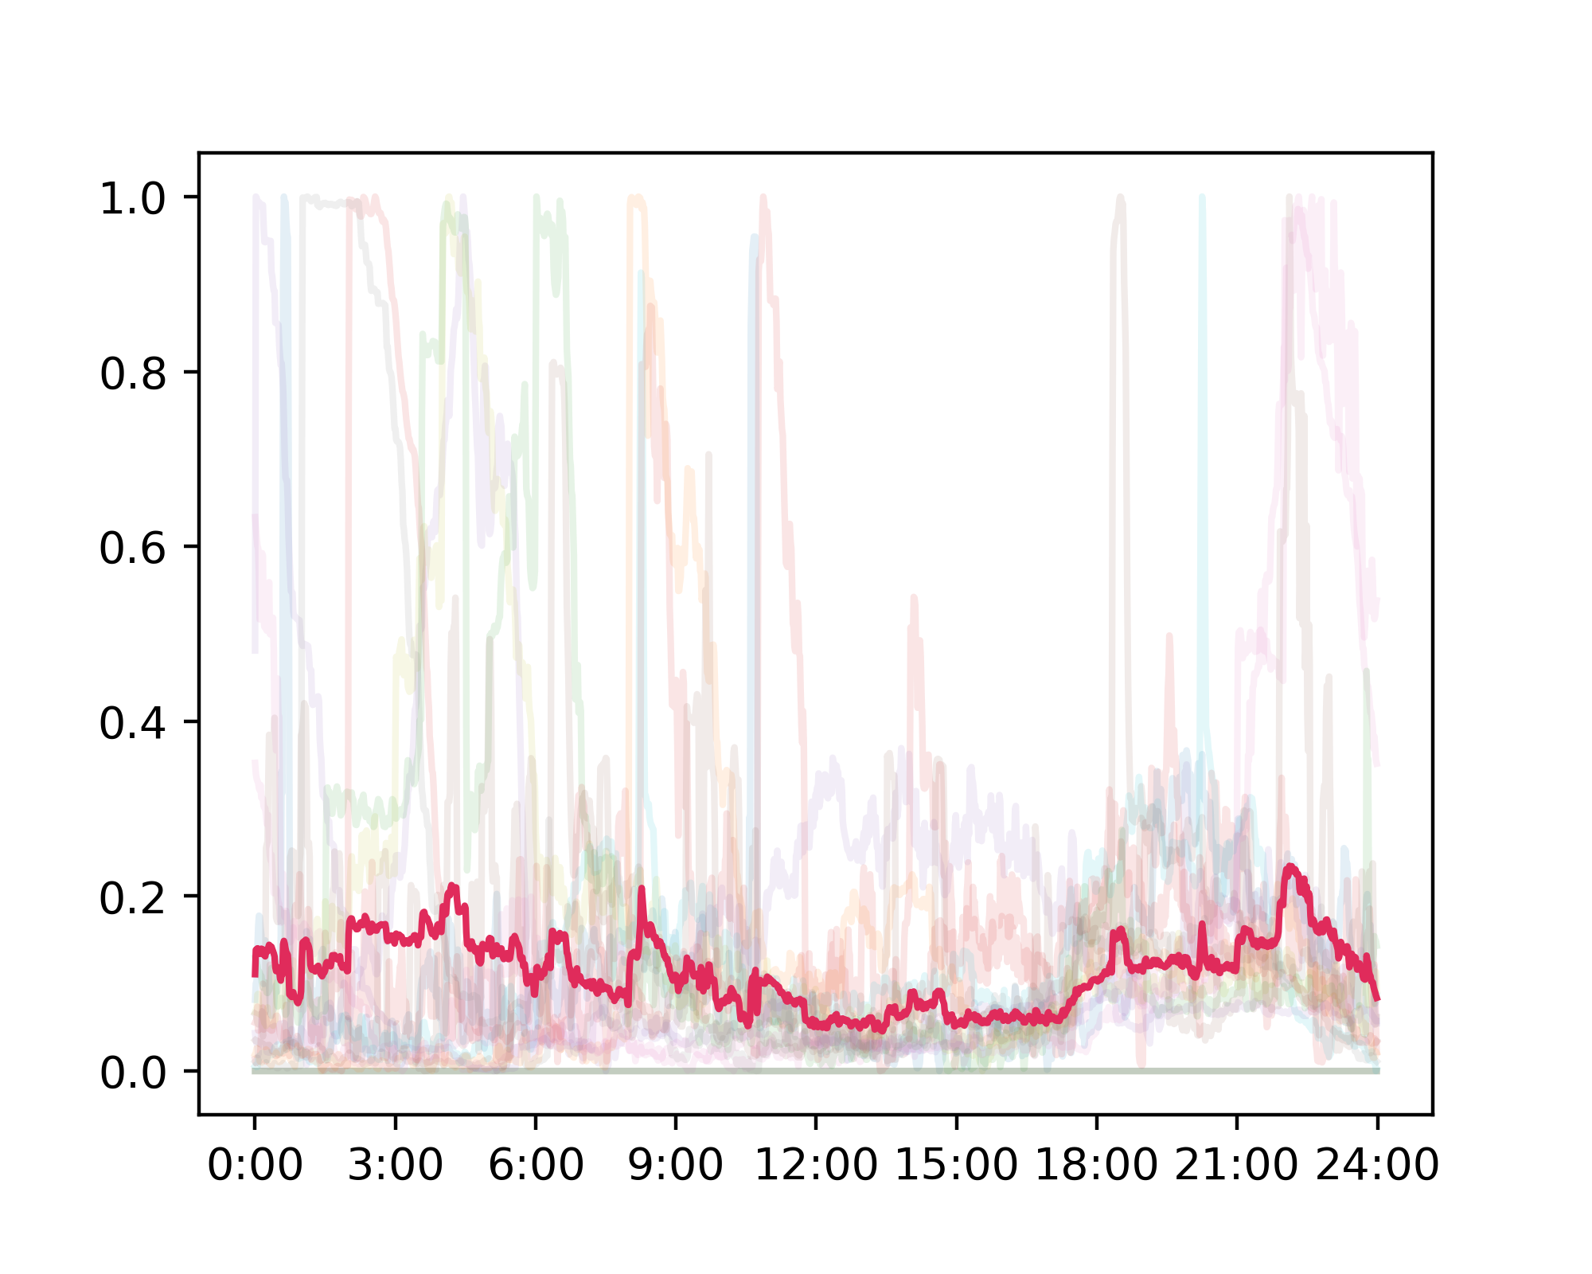
Results ( )
Cluster #1 (68)
Cluster #2 (66)
Cluster #3 (65)
Cluster #4 (49)
cluster means
Cluster #5 (47)
Cluster #6 (33)
Cluster #7 (18)

Slide 19
How do the results compare against the naive K-means?

Slide 20
How do the results compare against the naive K-means?
Well...

Slide 21
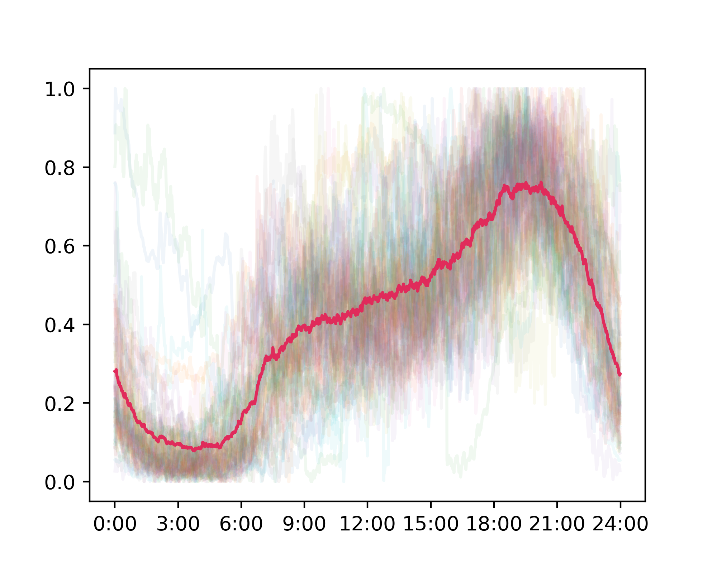
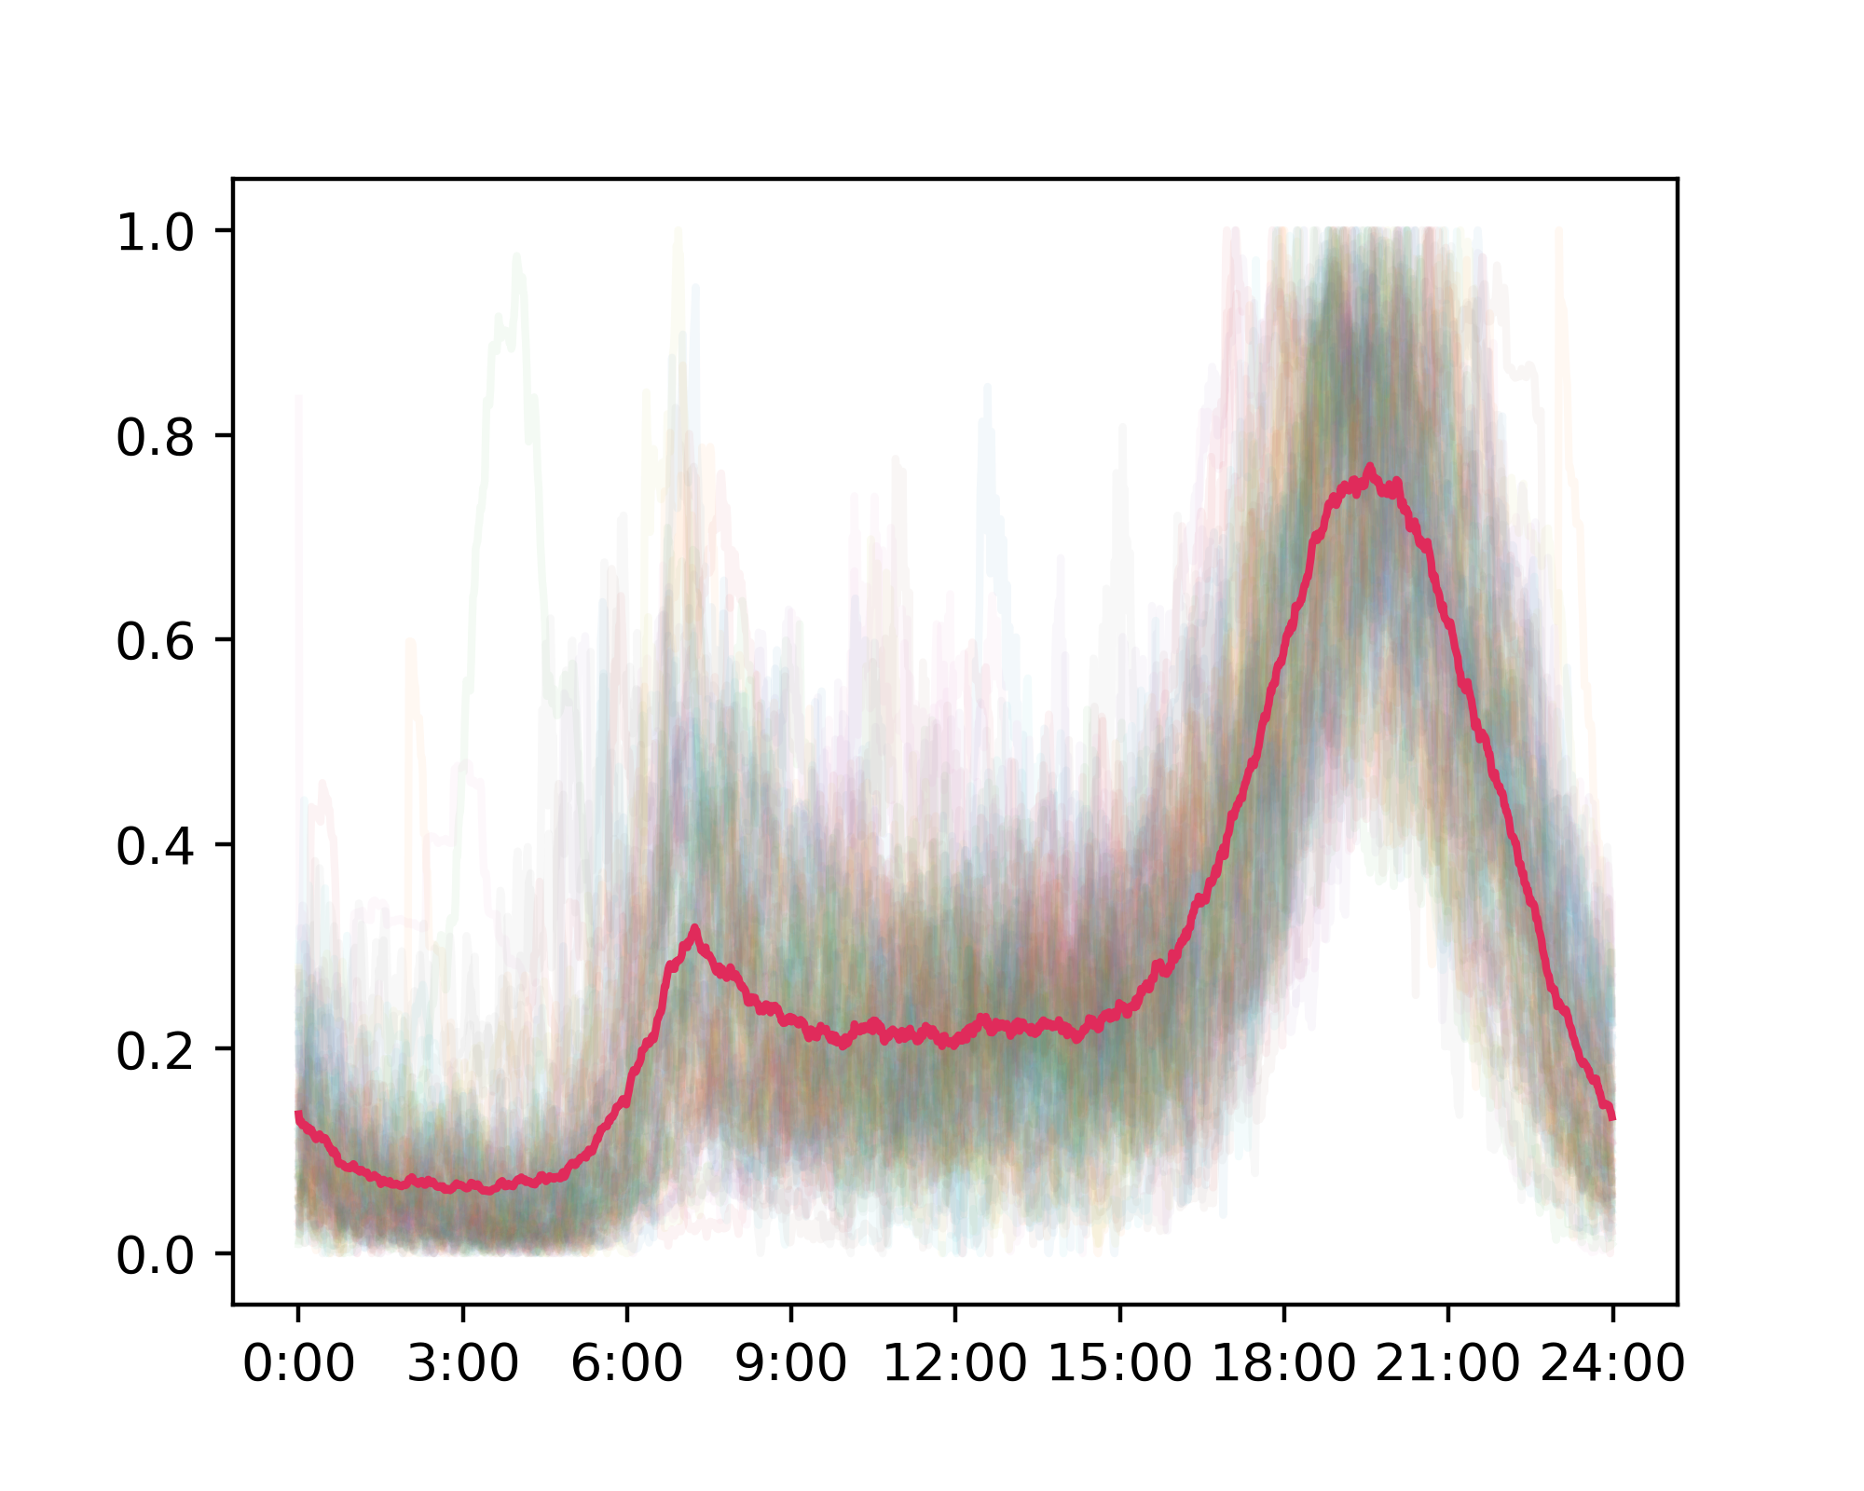
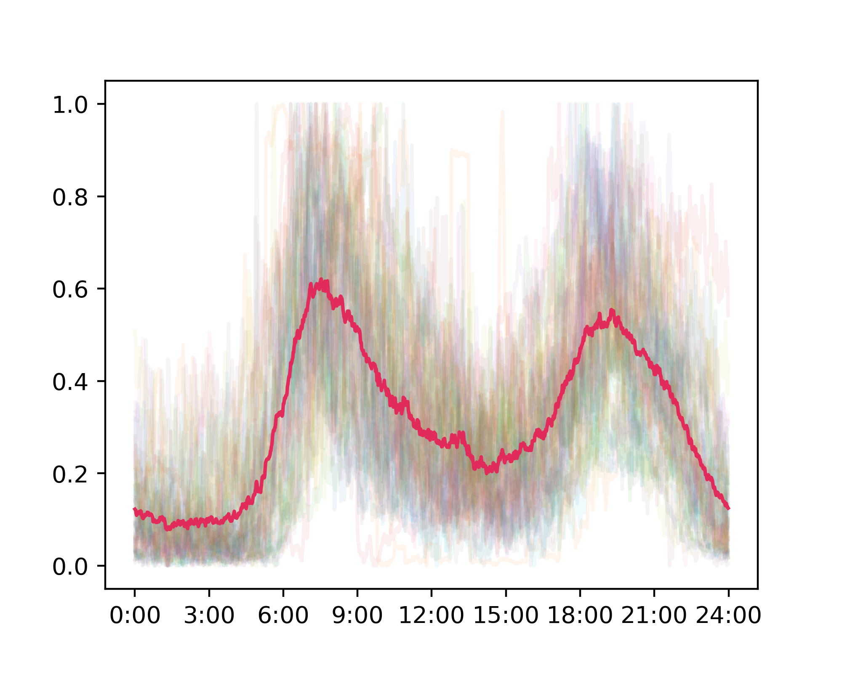
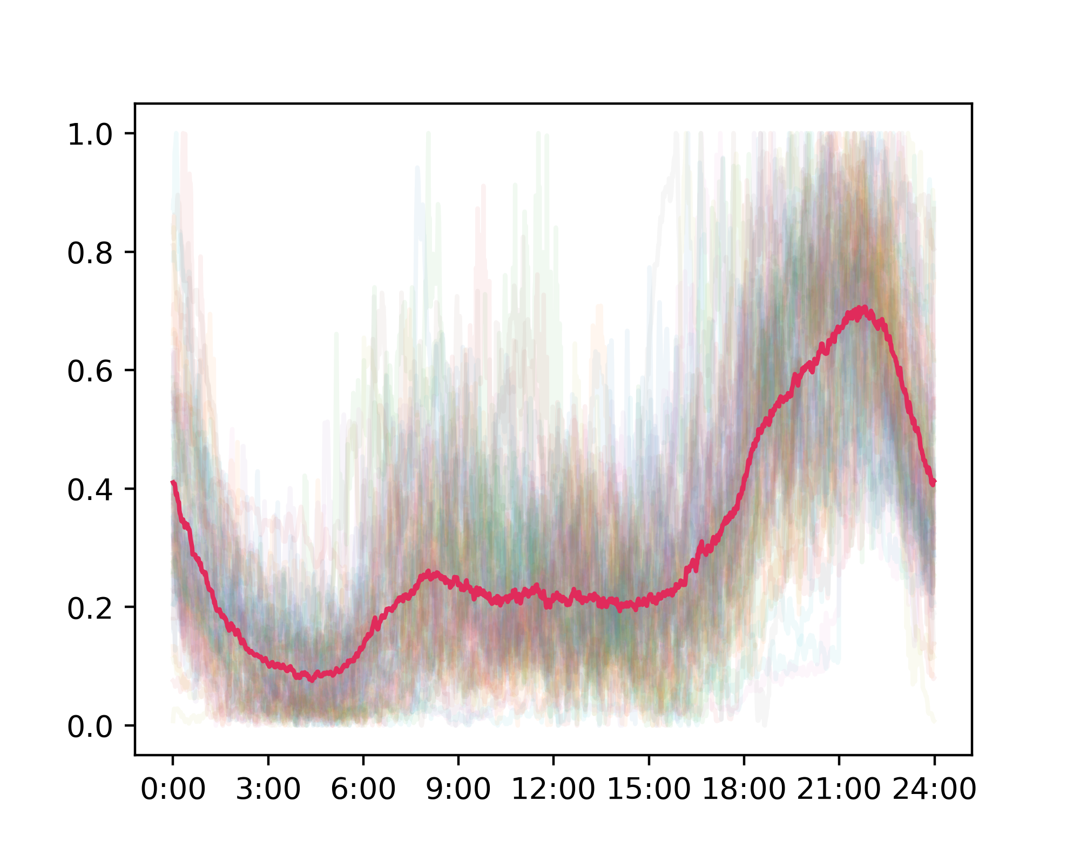
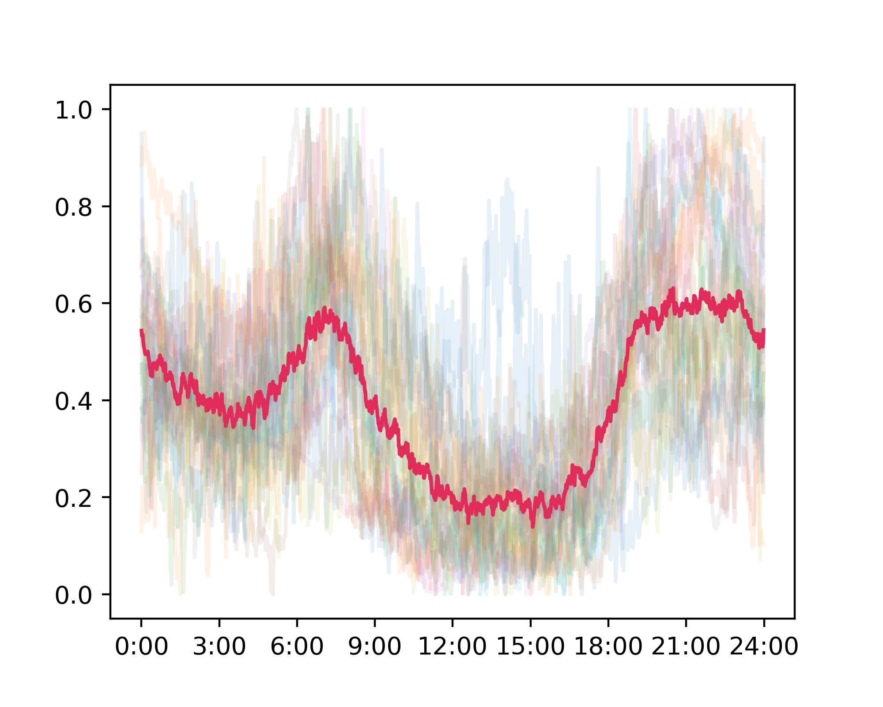
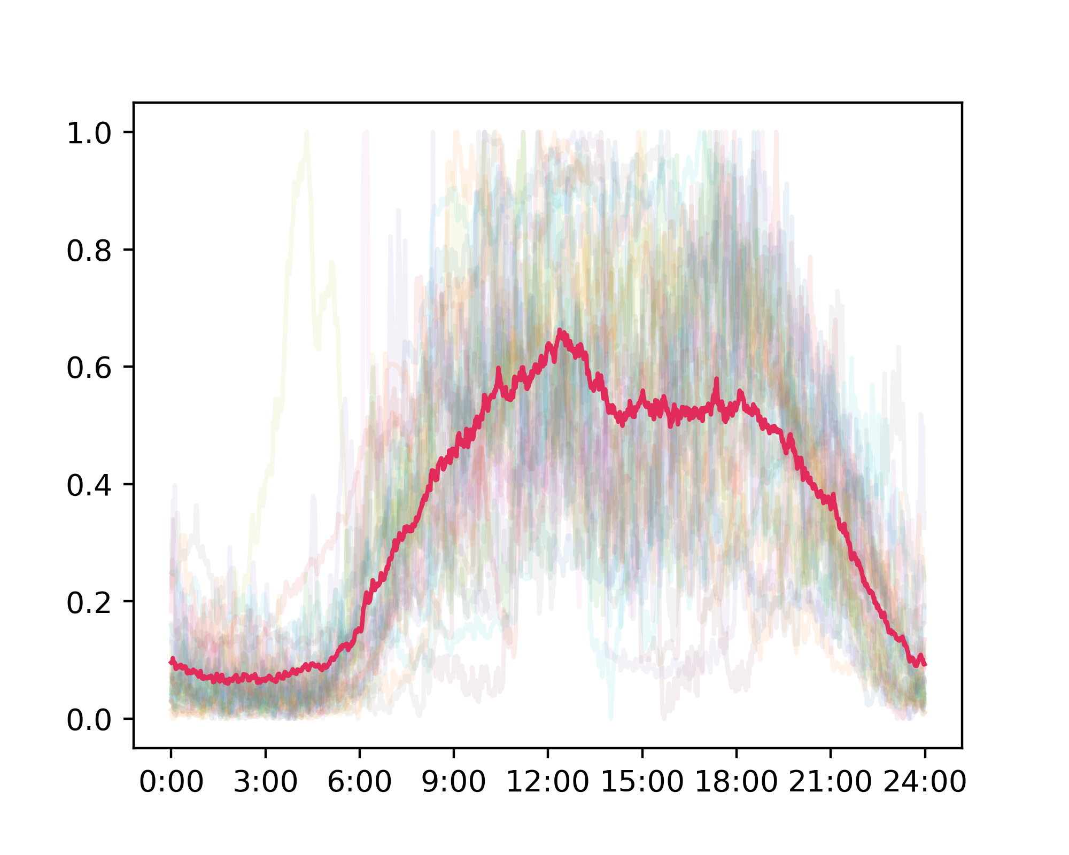

Results comparison: Clusters
Profile clusters generated by:
Autoencoder+K-means (upper) vs.
Naive K-means (lower)

Slide 22

Results comparison: Elbow plots

Slide 23
Why?

Slide 24
Curse of dimensionality, revisited
(Beyer, Goldstein, Ramakrishnan, Shaft)

Slide 25

Curse of dimensionality, revisited
(Beyer, Goldstein, Ramakrishnan, Shaft)
given
Load profiles of two residents may not be independent.
Entries (minutes loads) of a profile vector are highly correlated!
Correlations between entries can help avoid the concentration of distances (Durrant, Kabán)

Slide 26
Conclusions
Convolutional autoencoders can be used to reduce dimensionality and alleviate the effects of distance concentration on high-dimensional data.
In real-world scenario, the curse of dimensionality may often be tempered by the inherent structures of the data in interest.

Slide 27
Conclusions
Convolutional autoencoders can be used to reduce dimensionality and alleviate the effects of distance concentration on high-dimensional data.
In real-world scenario, the curse of dimensionality may often be tempered by the inherent structures of the data in interest.

Slide 28
Reference
[1] Beyer, Kevin, Jonathan Goldstein, Raghu Ramakrishnan, and Uri Shaft. "When is “nearest neighbor” meaningful?." In International conference on database theory, pp. 217-235. Springer, Berlin, Heidelberg, 1999.
[2] Durrant, Robert J., and Ata Kabán. "When is ‘nearest neighbour’meaningful: A converse theorem and implications." Journal of Complexity 25, no. 4 (2009): 385-397.

